Slide 1
Chapter 5: Dynamic Analysis-Test Design Techniques
Software Testing
Decision Table Testing

Slide 2
Decision Table Testing
Logic based testing technique
Systematic approach input and output in tabular form
Precise and compact way to model complicated logic
Conditions and actions are used for test cases
Conditions as inputs and actions as outputs

Slide 3
Why Decision table is important?
Search the effects of combinations of different
All possible combinations of conditions have been considered
Development process with the tester
- Developer
- Also for Tester
Dealing with complex business rules

Slide 4
Developing Decision Table
Decision table has following four portions
- Stub portion - Entry portion - Condition portion, and - Action portion
condition stubs | Condition Alternatives - condition entries
action stubs | action entries

Slide 5
Developing Decision Table
Conditions and Condition alternatives
-> Represent the specific rule when making a decision
Actions
-> Represent all possible courses of action associated with a given set of conditions
Two types of condition entries
- Limited entry table
- All conditions binary
- Extended entry table
- Condition entries have more than one value

Slide 6
Developing decision tables
Step 1:
Determine the number of conditions
- Combine rows that overlap conditions that are mutually exclusive.
- Example: Gender (Male and Female )
- Education (High school, Bachelor, Master and Doctor etc)
Step 2 :
Determine the number of possible actions
Number of conditions becomes the number of rows

Slide 7
Developing decision tables
Step 3 :
Determine the number of condition alternatives for each condition.
- Simple table have two alternatives (Y/N)
- Extended entry table many alternatives for each condition
Step 4 :
Calculate the number of possible combinations (Rules).
If four conditions and two alternatives, there will be 2^4 = 16 possibilities

Slide 8
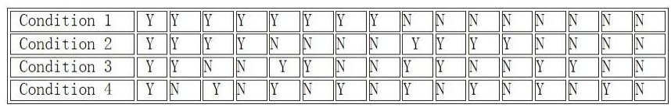
Developing decision tables
Step 5:
Fill Columns of the decision table with all possible combinations
6. Complete the table by inserting an X,T,1 where rules suggest certain actions.
-X means action should occur. We can also refer to it as T Or 1
- Blank means action should not happen. We can also represent it
as N Or F Or 0.
7. Combine rules where it is apparent that an alternative does not make a
difference in the outcome

Slide 9
Developing decision tables
8. Check the table for any impossible situations, contradictions, redundancies.
9. Rearrange the conditions and actions and write test cases based on the table.
Note:
Atleast One test case per column gives full coverage.

Slide 10
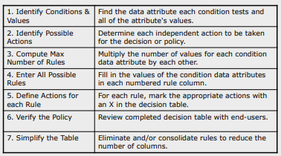
Decision Table Methodology

Slide 11
Decision table- Example 1
One condition
Two Conditions
Condition | Rule1 | Rule2
A | Y | N
Condition | Rule1 | Rule2 | Rule3 | Rule4
A | Y | Y | N | N
B | Y | N | Y | N

Slide 12
Decision table – Example 1
Three Conditions
Specifications:
All three conditions = Both outcomes
Any two out of three conditions = Outcome 1
No conditions = Outcome 2
Conditions | Rule1 | Rule2 | Rule3 | Rule4 | Rule5 | Rule6 | Rule7 | Rule8
A | Y | Y | Y | Y | N | N | N | N
B | Y | Y | N | N | Y | Y | N | N
C | Y | N | Y | N | Y | N | Y | N
Actions/ Outcomes
Outcome1 | Y | Y | Y | N | Y | N | N | N
Outcome2 | Y | N | N | N | N | N | N | Y

Slide 13
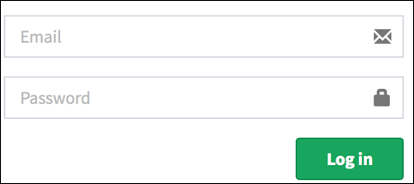
Example 2 :Login Screen
Decision Base Table for Login Screen

Slide 14
Decision Table-Example 2 Login screen
The condition is simple if the user provides correct username and password the user will be redirected to the homepage. If any of the input is wrong, an error message will be displayed.
4 Test Cases to check the functionality of login screen
Can we minimize the table??
Conditions | Rule 1 | Rule 2 | Rule 3 | Rule 4
Username (T/F) | F | T | F | T
Password (T/F) | F | F | T | T
Actions
Output (E/H) | E | E | E | H

Slide 15
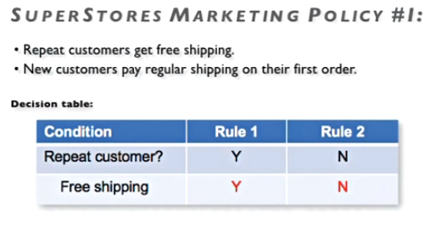
Decision Table- Example 3 Super Store

Slide 16
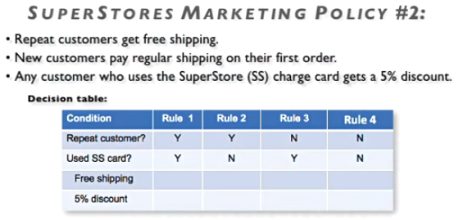
Decision Table- Example 3 Super Store

Slide 17
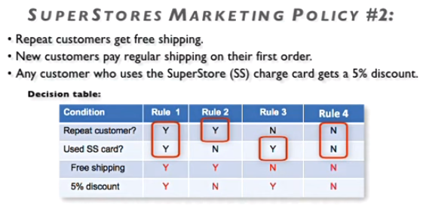
Decision Table- Example 3 Super Store

Slide 18
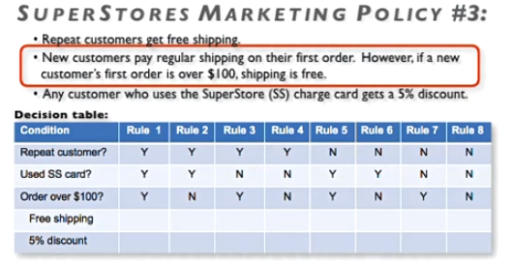
Decision Table- Example 3 Super Store

Slide 19
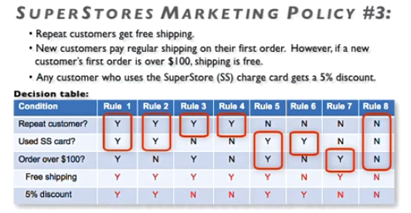
Decision Table- Example 3 Super Store

Slide 20
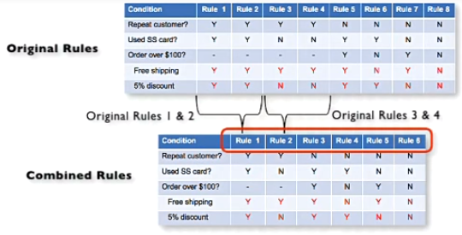
Decision Table- Example 3 Super Store

Slide 21
Advantages and Disadvantages of DT
Advantages:
System behavior is different for different input and not same for a range of inputs
Representation is simple as it is in tabular form
From table we have better testing coverage
Good for complex business conditions
Disadvantages:
When input increases table will become more complex

Slide 22

Class Task
Make Decision Table for Upload Screen
Now consider a dialogue box which will ask the user to upload photo with certain conditions like –
You can upload only '.jpg' format image
file size less than 32kb
resolution 137*177.
If any of the conditions fails the system will throw corresponding error message stating the issue and if all conditions are met photo will be updated successfully

Slide 23
Thank you

